Slide 1
Muladhara (Root Chakra)

Slide 2
Where is it located?
The chakras are 7 points along the body that hold energy.
Each Chakra is located a certain point along the spine
The Root Chakra is located at the base of the spine at the tailbone

Slide 3
I Am
The Root Chakra is the chakra that is associated with a certain stage in our development. When we are in the womb we start to develop and as babies we learn a sense of existence, stability and physical connection.

Slide 4
Out of Balance
Excessive Traits
Heavy
Sluggish
Overweight
Deficient
Spacey
Fearful
Underweight

Slide 5
Abuses of the Chakra - Things that Threaten Survival
Birth Trauma
Neglect
Malnourishment
Extreme Poverty
Physical Abuse
Serious Illness

Slide 6
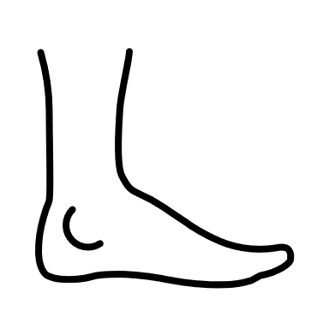
Parts of the Body Affected
Legs and Feet
Bones
Large Intestines
Base of Spine

Slide 7
Let’s Get a Little Deeper
Demon of this Chakra is Fear and Trust
Masculine energy pushes down into the ground
Feminine energy pulls it in and up
Element is earth
Chakra of Self Preservation

Slide 8
Learning the Fun Stuff
Crystals
Garnet
Red Tigers Eye
Red Carnelian
Red Jasper
Hematite
Mahogany Obsidian

Slide 9
Essential Oils
Ylang-Ylang
Myrrh
Patchouli
Vetiver
Rosewood
Thyme
Frankincense
Ginger

Slide 10
Herbs
Rosemary
Dandelion & Burdock
Cayenne Pepper
Chives

Slide 11
Healing Foods
Fruits
Blood Oranges
Cherries
Cranberries
Pink Grapefruit
Red Plums
Strawberries
Watermelon

Slide 12
Vegetables
Beets
Radishes
Red Peppers
Red Cabbage
Red Jalapeno
Red Onions
Red Potatoes
Tomatoes

Slide 13
Protein
Red Meats
Beef
Bison

Slide 14
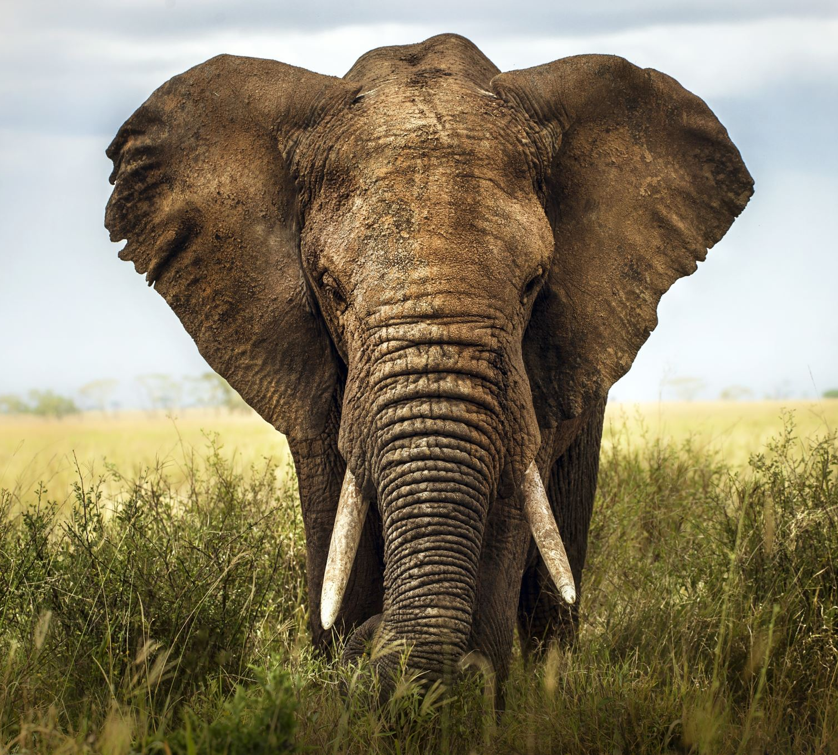
Chakra Animal
Stable and Grounded

Slide 15
Planets and Zodiac
Earth
Pluto
Capricorn
Virgo
Taurus

Slide 16
Sound Therapy
Musical Keynote of C
Frequency of 256Hz
Thunder
Chanting Lam

Slide 17
Mantras
I am
I have the right to be here
Lam

Slide 18
Let’s Get Healing

Slide 19
Grounding Breathwork
Root Lock Breathing
Start in a comfortable seated position. Sit nice and tall jaw relaxed. Inhaling through the nose exhaling through the mouth.
Inhale and pull the breath from deep down in the belly all the way up into the chest while counting to 5.
Hold for 1
Exhale through the mouth blowing and squeezing the air out for 5
Repeat 5-10x

Slide 20
Yoga Poses
Cobra- Grounds (the pelvis)
Downward Dog- Grounds the whole body. Grounding points are in the hands and feet
Forward Fold- Grounding down through the feet
Childs Pose- Quiets the nervous system
Chair pose- Grounds Through the feet and requires focus
Tree Pose- Requires Balance, Focus, and Breathwork
Mountain Pose- Grounds using stability
Corps Pose- Grounds and rests the entire body

Slide 21
Thank You!
Hope you enjoyed learning about the Root Chakra

